Slide 1
Data Extraction and Analysis of HDB Data
Course: NSDBA
Assignment: CA1
Name: Chio Tan Huat
Student ID: P7337998
Contents
Part 1: HDB Resale Data – Station & Filter and Show on Interactive Map Part 2: (A) HDB Resale Price Growth over the years
(B) HDB Resale Price vs Distance from MRT Station
Part 3: HDB Land Use Data
Part 4: HDB Lease-Remaining Information

Slide 2
Part 1 :
HDB Resale Data – Station & Filter and Show on Interactive Map
Datasets Applied:
HDB Resale Data: https://data.gov.sg/dataset/resale-flat-prices
LTA MRT Data: https://www.mytransport.sg/content/dam/datamall/datasets/Geospatial/TrainStation.zip
Town Boundary: https://data.gov.sg/dataset/master-plan-2014-planning-area-boundary-no-sea
ONE Map Query: https://docs.onemap.sg/#onemap-rest-apis (query address to SVY format)
Python Modules Used:
numpy
SVY() : Convert SVY coordinates in MRT data to Lat – Lon format
csv : extract relevant data from raw data set and write out to .csv files
request : url request from ONE Map (to obtain Lat – Lon from address)
shapefile : Read and manipulate .shp format from LTA MRT data
folium : Open source module for generating .html leaflets interactive map
webbroswer : Call default web browser to open .html files
os : To write out .html files generated from folium

Slide 3
Synopsis of Code: The code is written in Jupyter Notebook and divided into 3 snippets.
The 1st snippet opens and reads in the 4x datasets from HDB Resale Data that span 1990 – 2018. This is consolidated into a single “database” for ease of search. The 1st snippet also has functions that search the consolidated database.
The 2nd snippet allows the user to search the database according the user’s critieria and extract this to a smaller database. The address of each record is search against the OneMap database to obtain the lat-lon of the property. This is written to a external file “Property_Info.csv”.
The 3rd snippet reads in from “Property_Info.csv”, “MRT_Sations.csv” and “Singapore_Town_Boundaries.shp” and compute nearest MRT station to each property listed. The folium module is used to plot an interactive map with markers on each of the property list. The markers has both “mouse-over” and “pop-up” effects, displaying more information
Comments and Observations:
Python is fragmented but very powerful. One is almost always able to get online resources.
Dictionary and Sets are very useful to complement List.
Dictionary is used as a way to search via keys.
By going back and forth between Lists and Sets, one is able to filter out unique entries very efficiently.
Folium is a very powerful wrapper for Leaflet (which is JavaScript library for interactive map)
Doing simple GUI seems to be more difficult than MATLAB

Slide 4
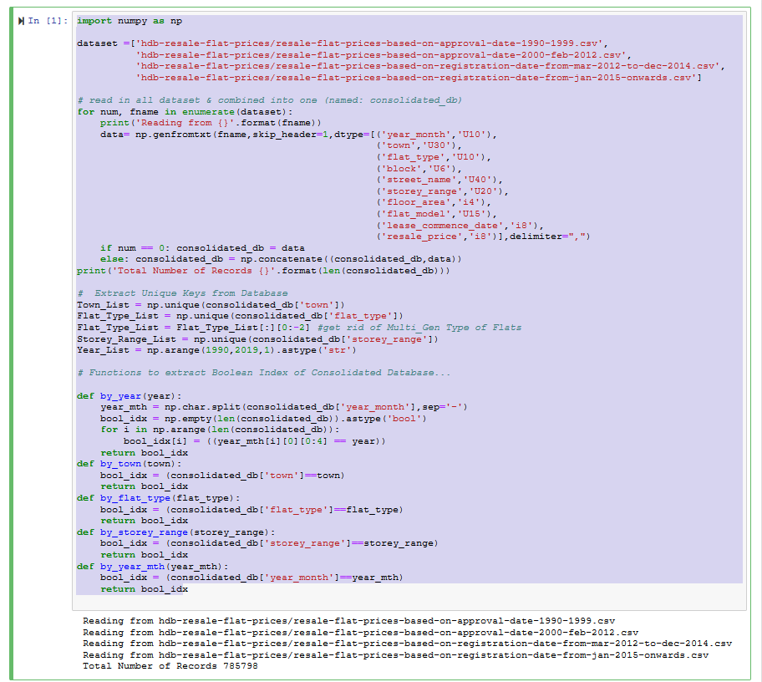
Jupyter Notebook: SNIPPET 1
Code
Output

Slide 5
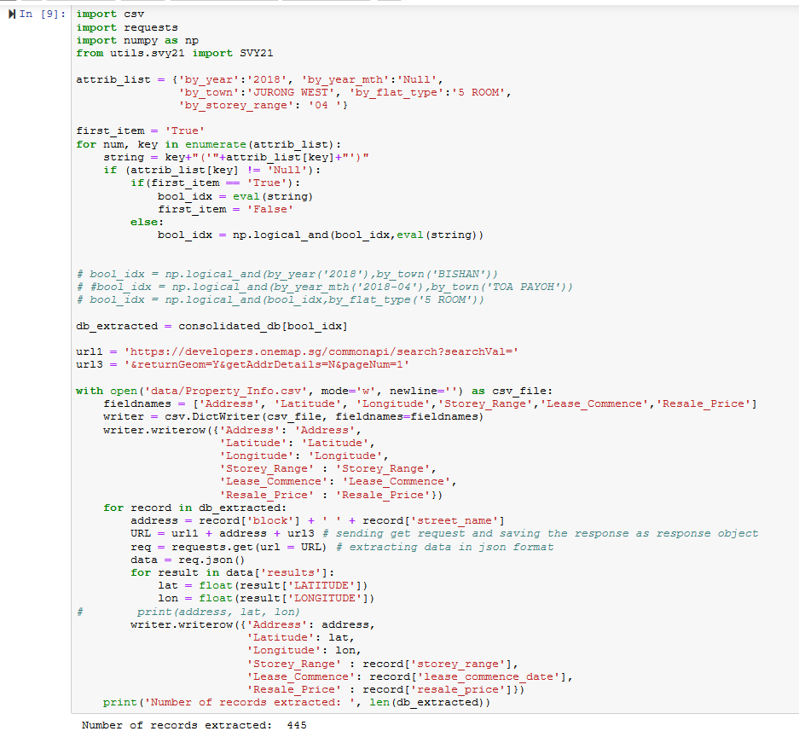
Jupyter Notebook: SNIPPET 2
Dictionary used to set the filters.
If value = “Null” then it will not be included
Loop to obtain the Boolean Index to extract from “consolidated_db”
{extracted_db} = subset {consolidated_db}
Setup url format to query OneMap database to obtain Lat-Lon for each record in {extracted_db}
Write relevant data to “Property_Info.csv”
In this case, 445 records are extracted and written to “Property_info.csv”

Slide 6
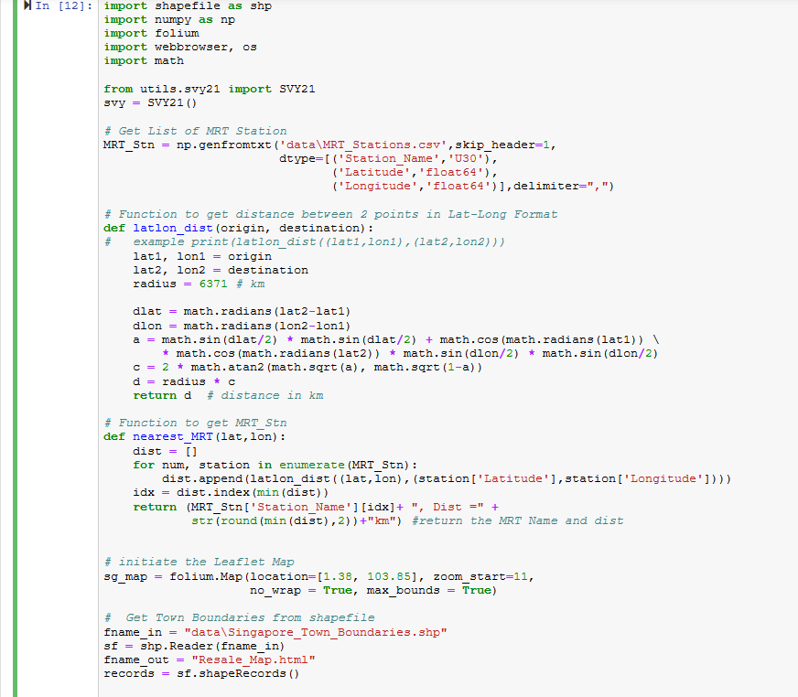
Jupyter Notebook: SNIPPET No. 3 (I)
List of MRT_Station: prepared offline from LTA Datamall data
Function to get distance between 2 points, given their Lat-Lon coordinates
Function to get distance between 2 points, given their Lat-Lon coordinates
Initiate an Folium Map Object. Note the the median Lat-Lon coordinate of S’pore
Get the Town Boundaries obtained from 2014 Singapore Master Plan.

Slide 7
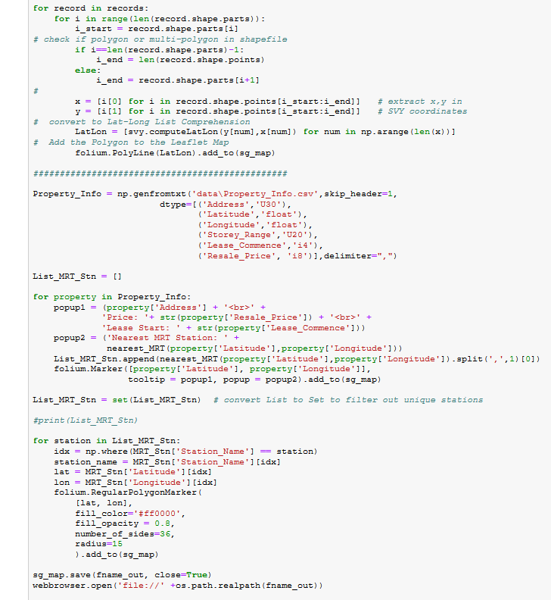
Jupyter Notebook: SNIPPET No. 3 (II)
Loop to plot the boundaries on the Folium Map
Read in the list of properties generated from Snippet No. 2
Get closest MRT station of each property and calculate their distance
Plots the MRT Stations in the vincinty. Note the use of Sets-Lists to filter out unique stations
Write to .html file and open in default webbrowser

Slide 8
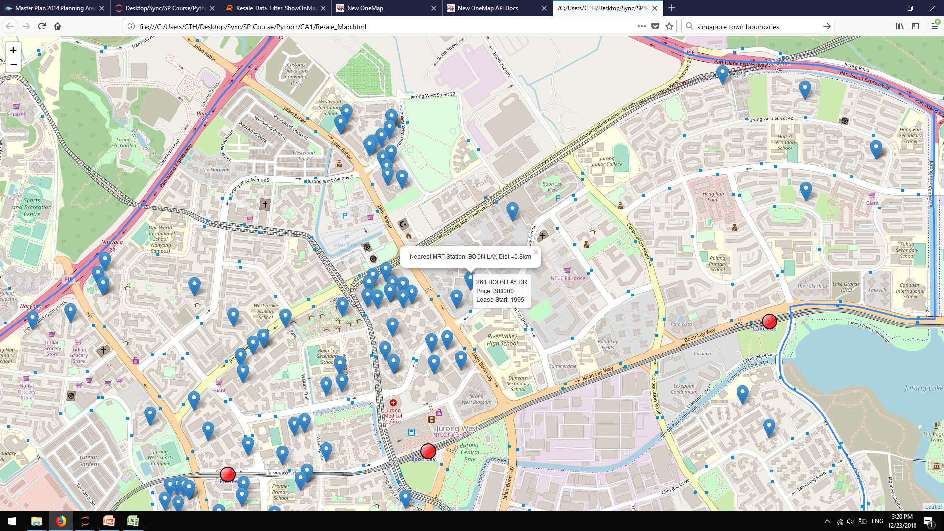
Mouse Over and Pop-up
MRT Station

Slide 9
Part 2:
HDB Resale Price Growth over the years
HDB Resale Price vs Distance from MRT Station
Datasets Applied:
HDB Resale Data: https://data.gov.sg/dataset/resale-flat-prices
LTA MRT Data: https://www.mytransport.sg/content/dam/datamall/datasets/Geospatial/TrainStation.zip
ONE Map Query: https://docs.onemap.sg/#onemap-rest-apis (query address to SVY format)
Python Modules Used:
numpy
matplotlib – (A) Simple Line Plots (in 2x2 subplots), (B) Scatter plot with simple ployfit regression
Synopsis of Code: Code is written in Jupyter Notebook; This code re-use the code from Part 1 that reads in the HDB resale prices.
Comparison of 2-, 3-, 4- and 5-room flats resale values from 1990 – 2018. For the 2-room flats, note that the median price tracks the mean relatively closely for the entire duration. As the size of the flats increase, there is a corresponding deviation of the mean from the median price, with a upward skew. For the bigger flats, this meant that a minority of outliers that skew the price upward thereby resulting news making million dollar resale flats.
In the analysis of HDB Resale vs Distance from MRT Stations, only data from Ang Mo Kio in Year 2018 is used.
The (lat-lon) of AMK MRT is hardcoded and again, the portion makes use of the part of the codes in the Part 1 that extract the distance of each record from AMK-MRT.
The scatter plots are plotted for 3-Room, 4-Room and 5-Room types; and simple regression is plotted for them. It is a surprise that for the 3-Room flat-type, the correlation is not strong. The correlation for 4-Room and 5-Room is stronger.

Slide 10
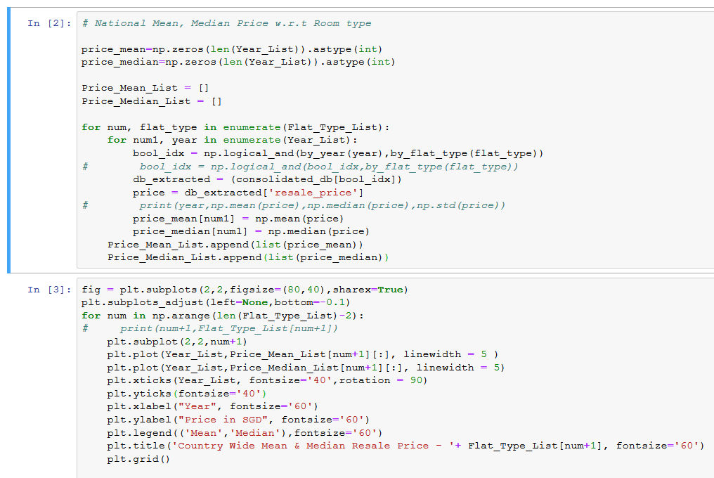
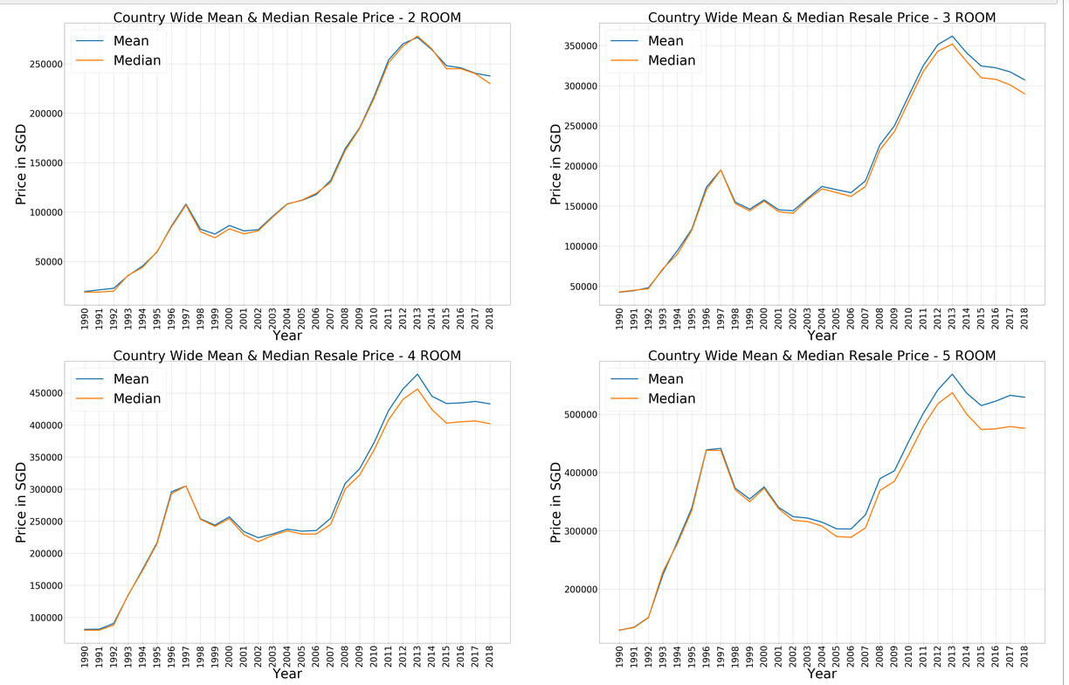
Part 2A
Look at all data & compute mean and median
Simple Line Plots in a 2x2 subplot frame

Slide 11
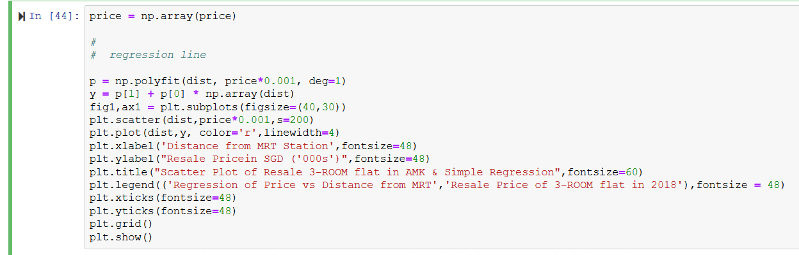
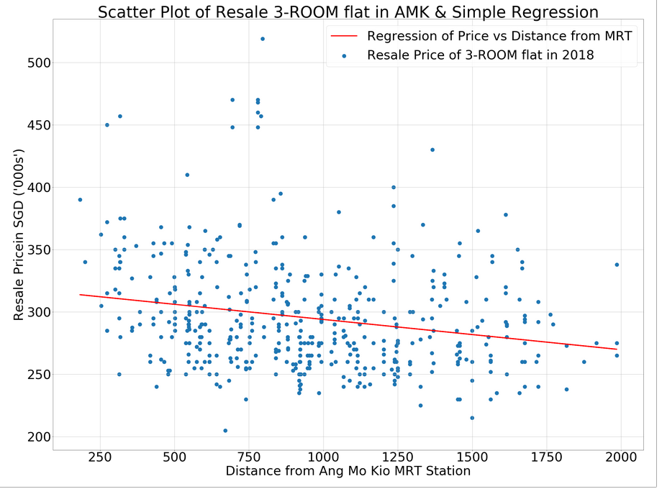
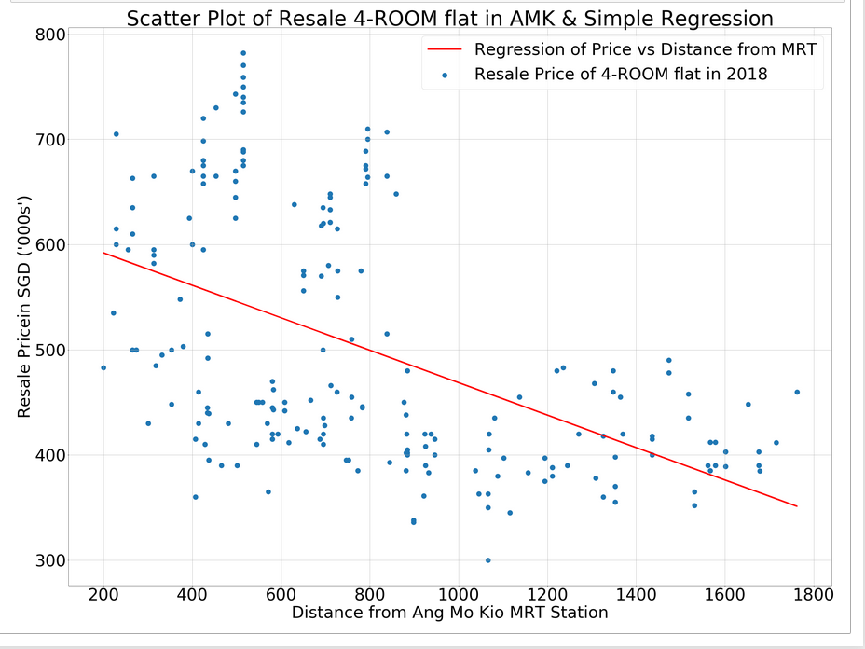
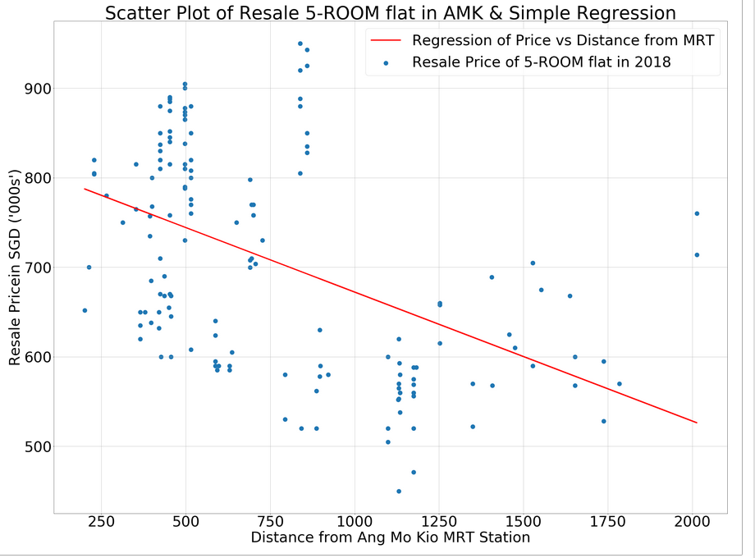
Part 2B

Slide 12
Part 3:
HDB Land Use Data
Datasets Applied:
HDB Land Use Data: https://data.gov.sg/dataset/land-area-and-dwelling-units-by-town
The data contains the number of HDB in each of the township from year 2008 – 2016. For each town, to total land area that for HDB flats are given. As such the density of each town can be computed and the growth can be visualised over the year. Another interesting fact is that the maximum number of HDB blocks are also given for each town. This will give an indication of the population growth in future.
Python Modules Used:
numpy
matplotlib
Barchart
Boxplot
Synopsis of Code: The code is written in Jupyter Notebook and divided into 3 snippets.
The 1st snippet opens and reads in land use data, plots the number of HDB blocks in each town in Year 2016 in a colored barchart format.
The 2nd snippet computes the various metrics and compares the density of each town in Year 2016 and the maximum planned density; in a side-by-side barchart format.
The 3rd snippet consolidates all the years of data and plots the distribution of density of each town in a barplot. This is again compared with the maximum planned density.

Slide 13
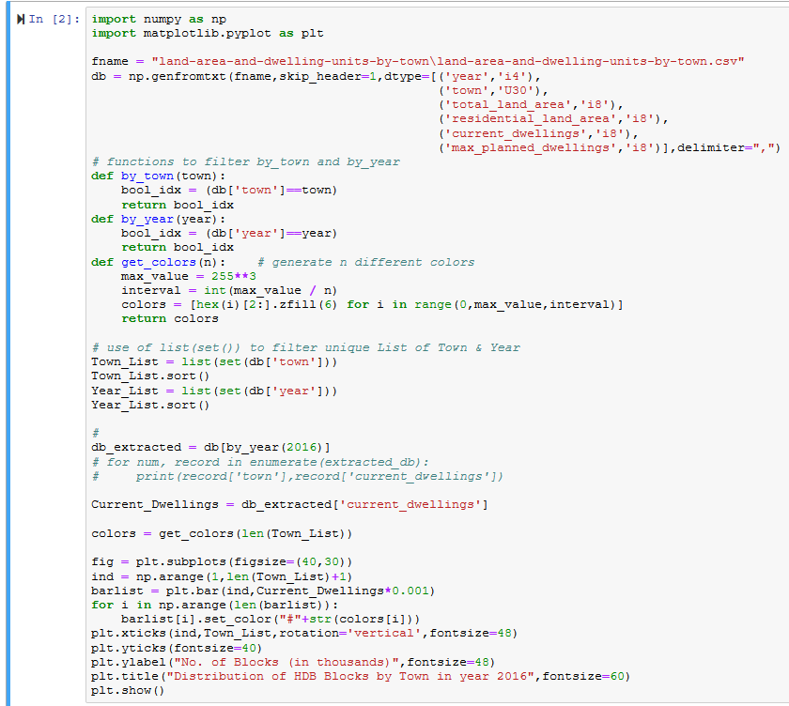
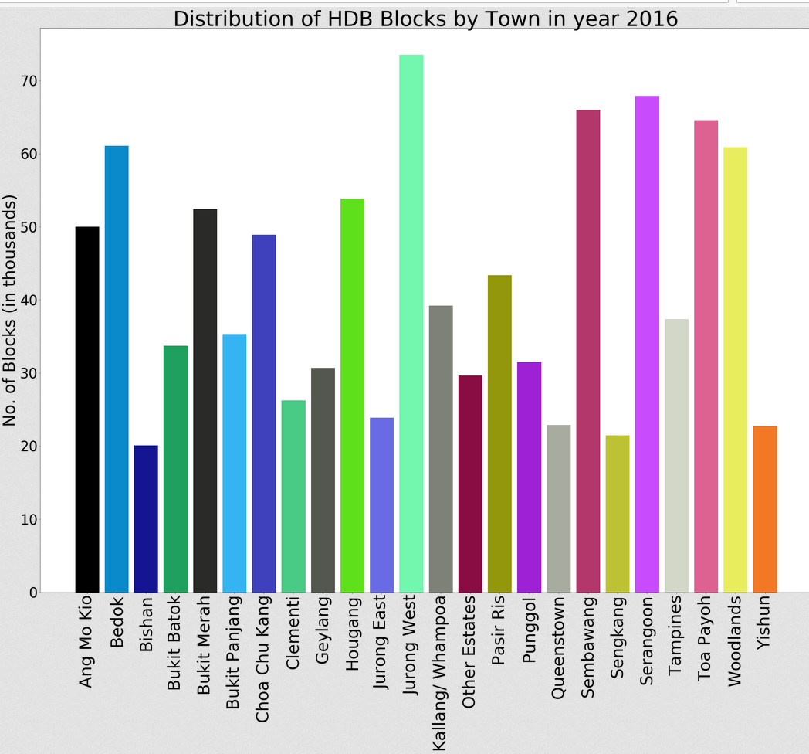
Read in data
Filtering and Extracting Data

Slide 14
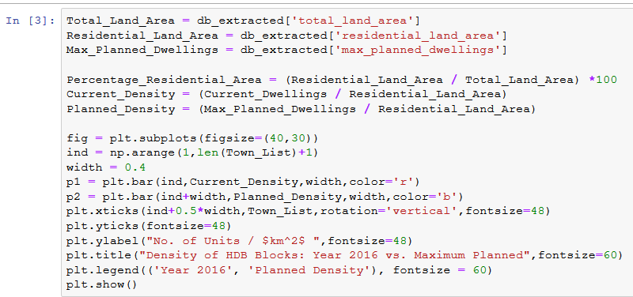
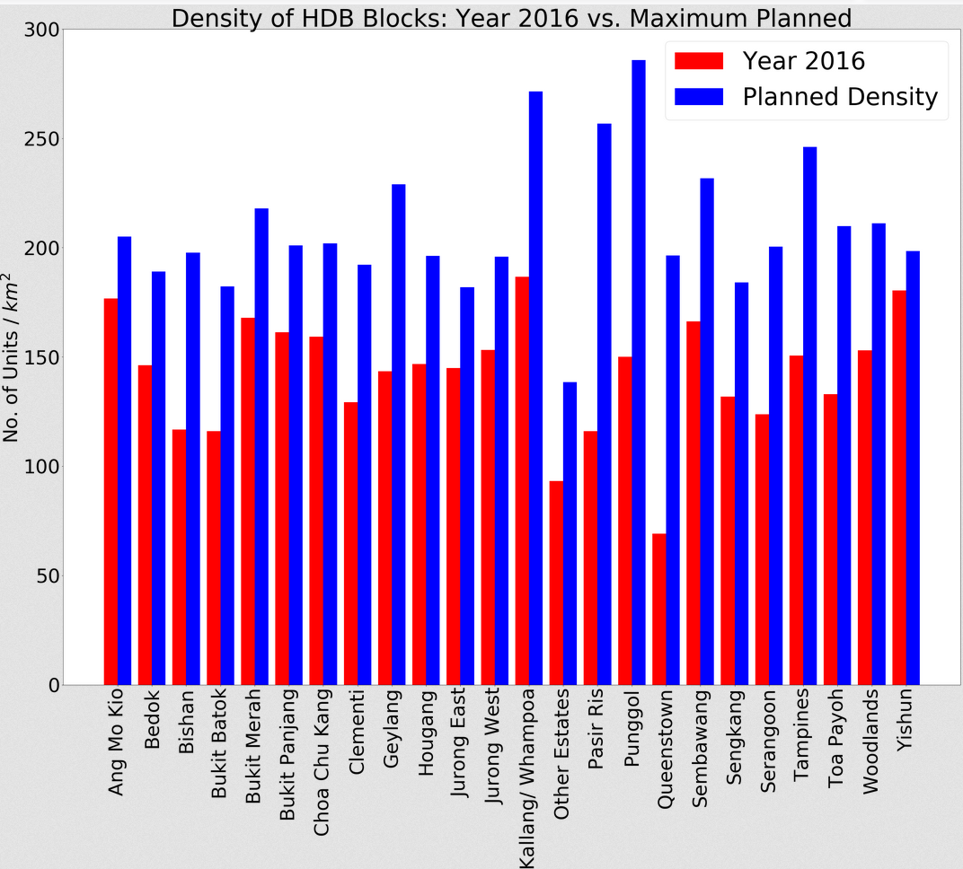
Rudimentary Computations
Plotting comparative barcharts

Slide 15
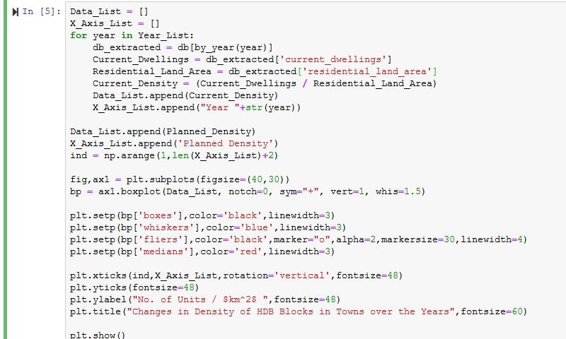
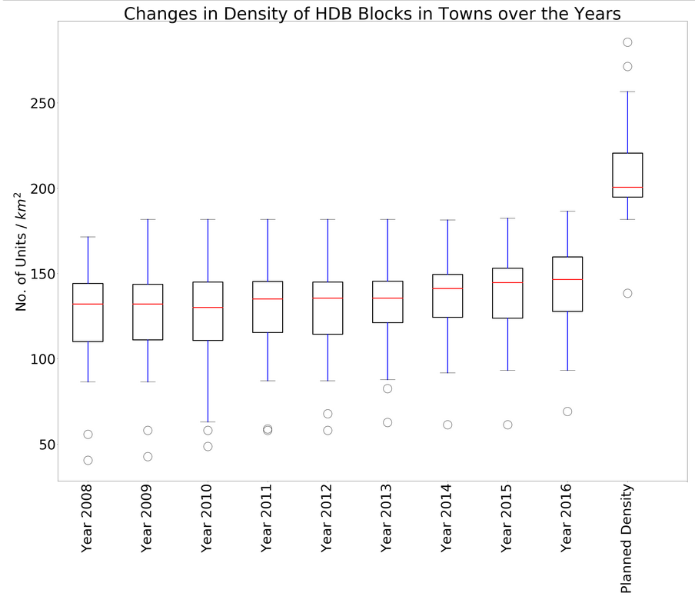
Consolidated data for each Town by Year
Plotting comparative boxplots

Slide 16
Part 4:
HDB Lease-Remaining Information
Datasets Applied:
HDB Land Use Data: https://data.gov.sg/dataset/hdb-property-information
This database contains the characteristics of each HDB blocks in each township. Information include the number of flat-types, the number of floors, the year completed etc.. in each block
Perhaps, the more interesting one is a comparison of the age of each town. This can be done by plotting the histogram of the distribution of blocks by years-of-lease remaining. RMS of the “Cubic spline” of the distribution make the visualization easier.
Python Modules Used:
numpy
matplotlib.pyplot - Barchart for plotting histogram
csv – for using Dict.Reader for file i/o to preserve the rich header of keys information in the .csv file.
spline.interpolate – for performing “cubic” spline to smooth out line plot
Synopsis of Code: The code is written in Jupyter Notebook and divided into 3 snippets.
Instead of “np.genfromtxt”, use “csv.DictReader” to read in the .csv and preserve the headers of keys.
As the data is not order, the code proceeds to filter the database according to the “Year Completed” and “Town”. As the database also contains HDB commercial buildings, these are filtered out. The blocks in each town in put into a List and a List-of-List of all the towns are created.
As a example, a histogram that combines the data from AMK and Bishan is plotted and compared.

Slide 17
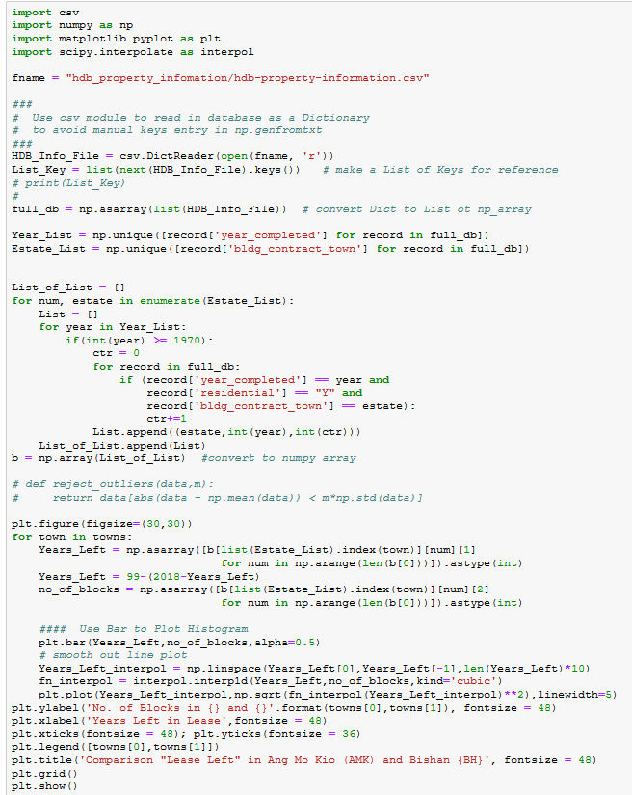
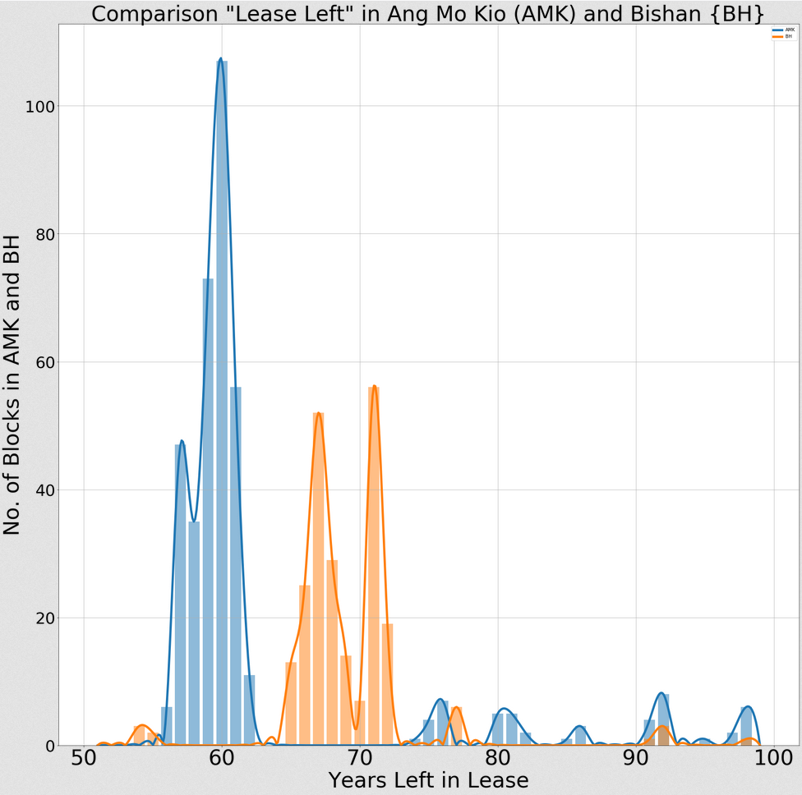
File i/o
Create List of Lists
Plotting

